Slide 1

ML FUNDAMENTALS
Data & Model Evaluation
Essential concepts for robust machine learning pipelines.

Slide 2

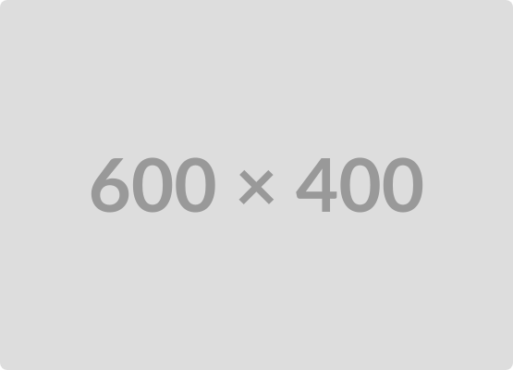
The Dataset
The Foundation of Learning
The dataset is the collection of examples (data points) used to train, validate, and test a machine learning model.
Must be representative of the real-world problem.
High-quality data is far more critical than complex algorithms.
Data can include features (inputs) and labels (outputs/targets).

Slide 3






Data Splitting: Training, Validation, and Testing
Training Set (70-80%)
Validation Set (10-15%)
Testing Set (10-15%)
The primary portion of data used to teach the model. The model learns weights and biases from this data.
Used to fine-tune the model's hyperparameters (settings) and check for early signs of overfitting during training.
An entirely untouched subset used for the final, unbiased evaluation of the model's generalization ability.

Slide 4

Training Cycle: The Epoch
An Epoch represents one complete pass through the entire training dataset during the learning process.
Definition: When every single data point in the training set has been used exactly once to update the model's parameters.
Goal: Multiple epochs (e.g., 50, 100) are typically required for the model to learn the optimal patterns and converge.
Related: Data is often split into smaller batches, and multiple *iterations* (steps) make up a single epoch.

Slide 5

Robust Evaluation: Cross-Validation
Ensuring Reliability
A technique used to evaluate the generalization ability of an ML model and mitigate the risk of sampling bias.
The training data is repeatedly split into *k* subsets (folds).
The model is trained *k* times, each time using a different fold as the validation set.
The final performance metric is the average of the results from all *k* tests.
Standard method: K-Fold Cross-Validation.

Slide 6
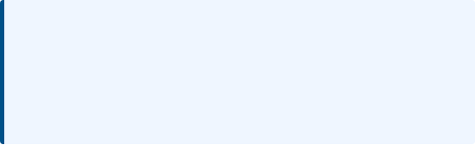
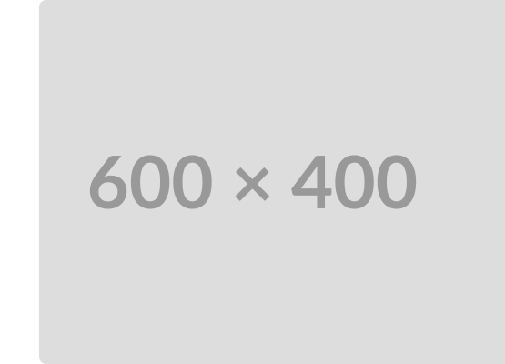
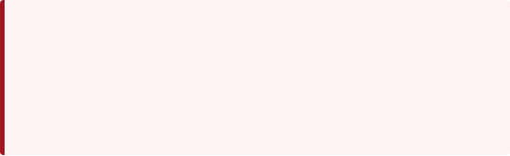
Model Fit: Overfitting and Underfitting
Overfitting (High Variance)
When the model learns the training data and noise too well, resulting in high accuracy on the training set but poor performance on new data.
[Image of overfitting and underfitting in machine learning regression]
Underfitting (High Bias)
When the model is too simple to capture the underlying relationships in the data, resulting in poor performance on both training and new data.
The goal is to find the "Just Right" or Optimal Fit between these two extremes.

Slide 7


Discussion & Q&A
Exploring further questions on model tuning and evaluation.

